Slide 1
Mobile Application Development
David Drohan (ddrohan@wit.ie)

Slide 2
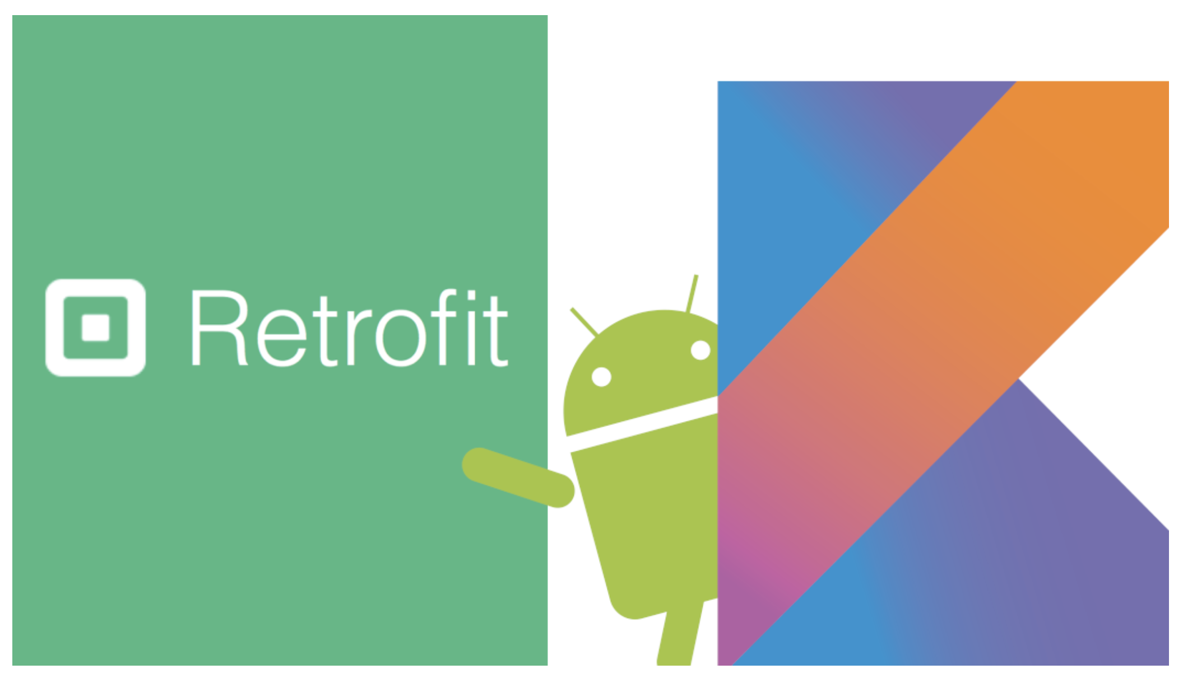
Networking with Retrofit

Slide 3
Agenda
Networking Overview
Annotations and Classes
Revisit interfaces
How to integrate Retrofit into an Android App (Donation)

Slide 4
Overview
In a nutshell, android networking (or any networking) works with the following:
Request— Make an HTTP request to an URL (called an endpoint) with proper headers (generally with Authorisation Key if required)
Response — The Request will return a response which can be error or success. In the case of success, the response will contain the contents of the endpoint (generally in JSON format)
Parse & Store — parse this JSON and get the required values and store them in our data class

Slide 5
Overview
In Android, we use
Okhttp — for creating an HTTP request with all the proper headers
Retrofit — for making the request
Moshi / GSON — for parsing the JSON data
Kotlin Coroutines — for making non-blocking (main thread) network requests
Picasso / Glide— for downloading an image from the internet and setting it into an ImageView

Slide 6
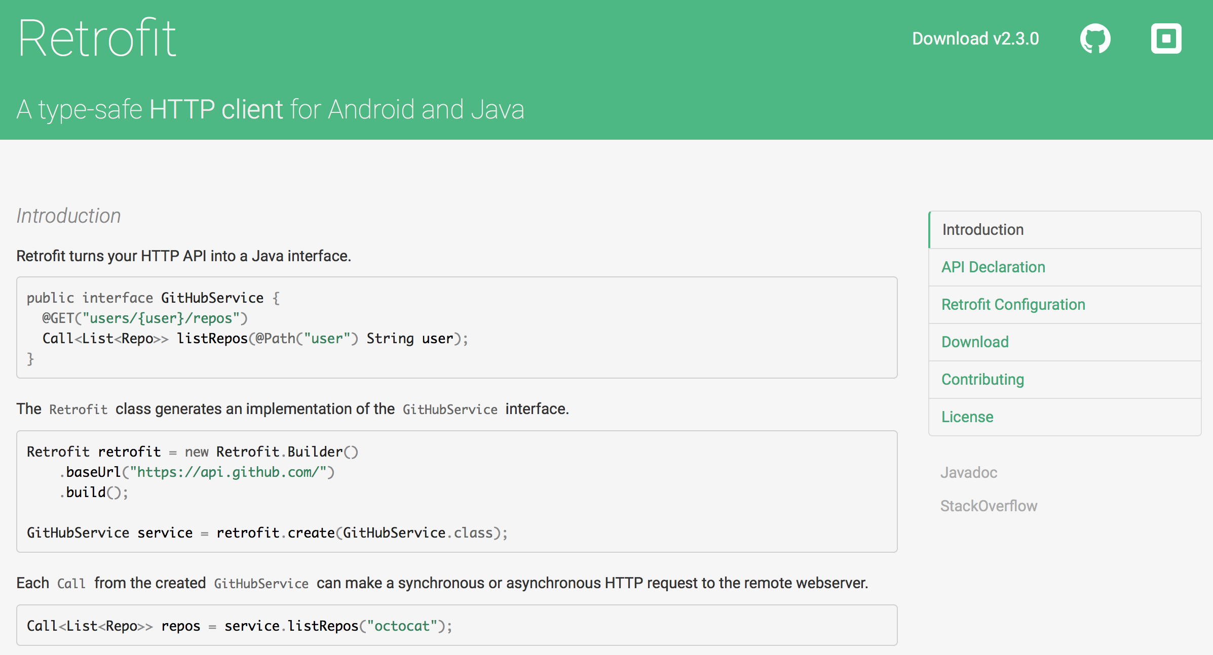


Slide 7
What is it?
Retrofit is a Java Library that turns your REST API into a Java/Kotlin interface
Simplifies HTTP communication through declarative & type-safe interfaces
Developed by Square (Jake Wharton)
Retrofit is one of the most popular HTTP Client Library for Android as a result of its simplicity and its great performance compared to the others (next slide)
Retrofit makes use of OkHttp (from the same developer) to handle network requests

Slide 8
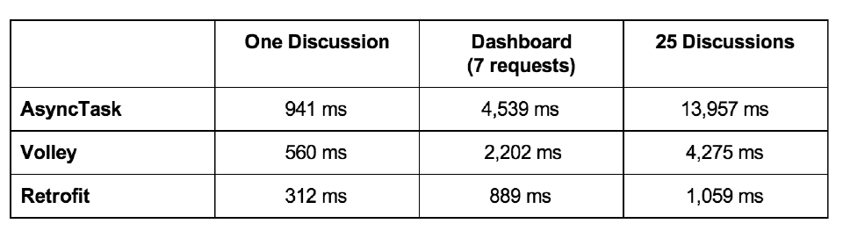
Retrofit Performance Analysis

Slide 9
Why Use it?
Developing your own type-safe HTTP library to interface with a REST API can be a burden: you have to handle many functionalities such as making connections, caching, retrying failed requests, threading, response parsing, error handling, and more
Retrofit, on the other hand, is very well planned, documented, and tested—a battle-tested library that will save you a lot of precious time and headache

Slide 10
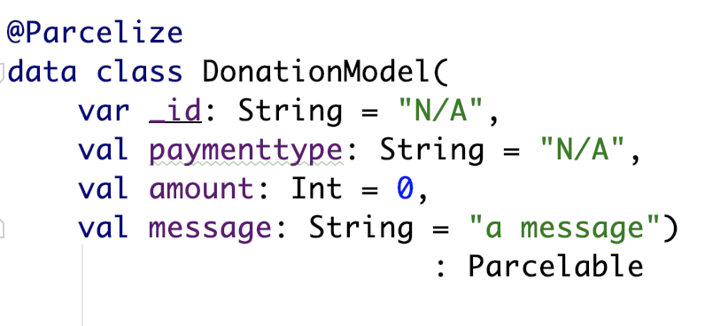
The Basics
Retrofit2 is a flexible library that uses annotated interfaces to create REST calls.
To get started, let’s look at our Donation example that makes a GET request for Donations.
Here’s the DonationModel class we’ll be using:
Much simpler if field names matches server model (but doesn’t have to, see later)

Slide 11
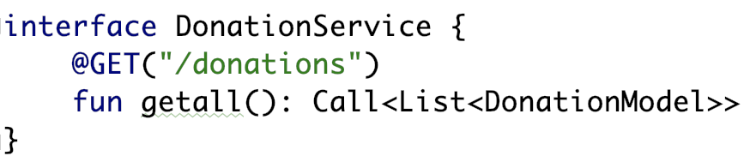
The Service interface
Once we’ve defined the class, we can make a service interface to handle our API. A GET request to load all Donations could look something like this:
Note that the @GET annotation takes the endpoint we wish to access. As you can see, an implementation of this interface will return a Call object containing a list of Donations.

Slide 12
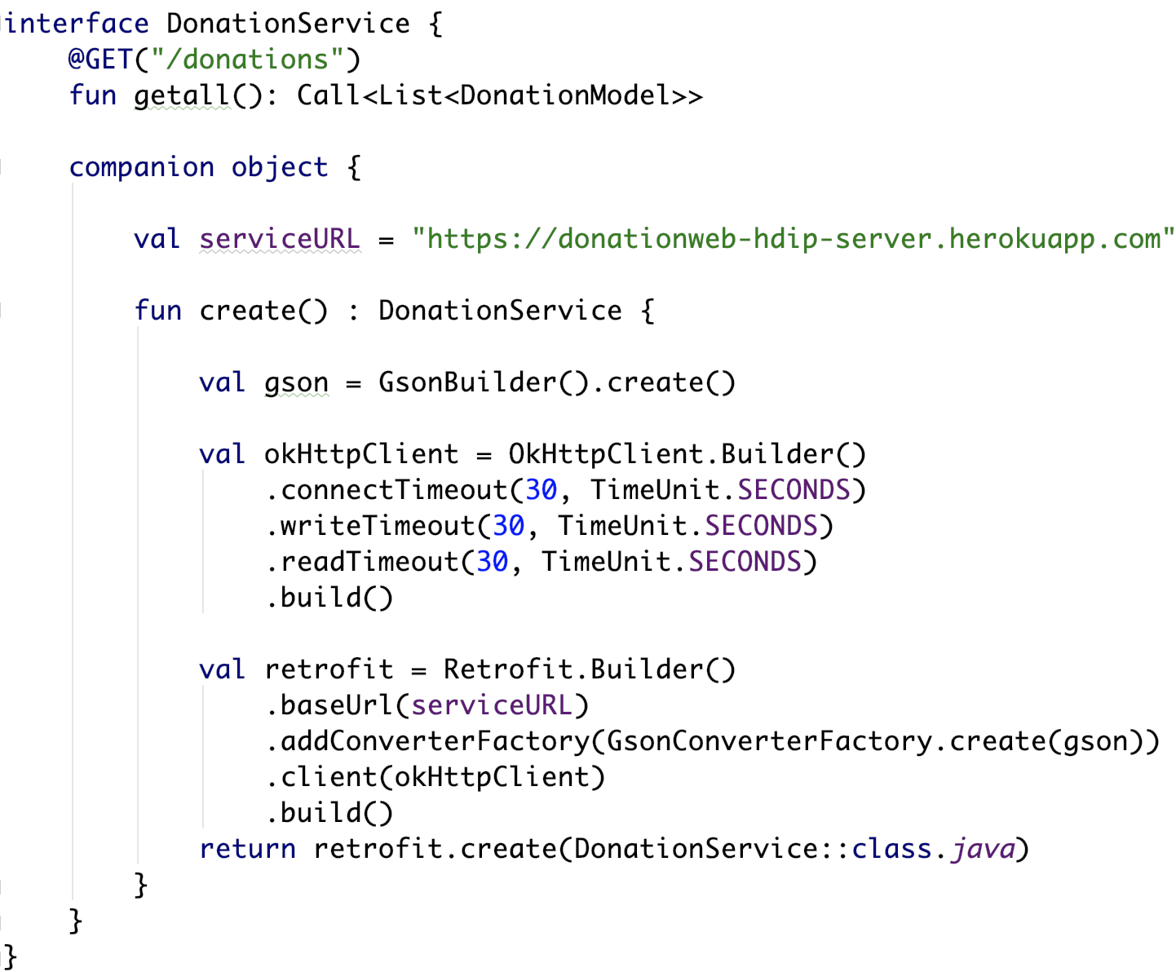
The Service interface
We also need to build a proxy service with the appropriate Gson parsers
‘Wrap it up’ inside a singleton create() method
Gson for converting our JSON
OkHttpClient for communication timeouts (optional)
Retrofit.Builder to create an instance of our interface

Slide 13
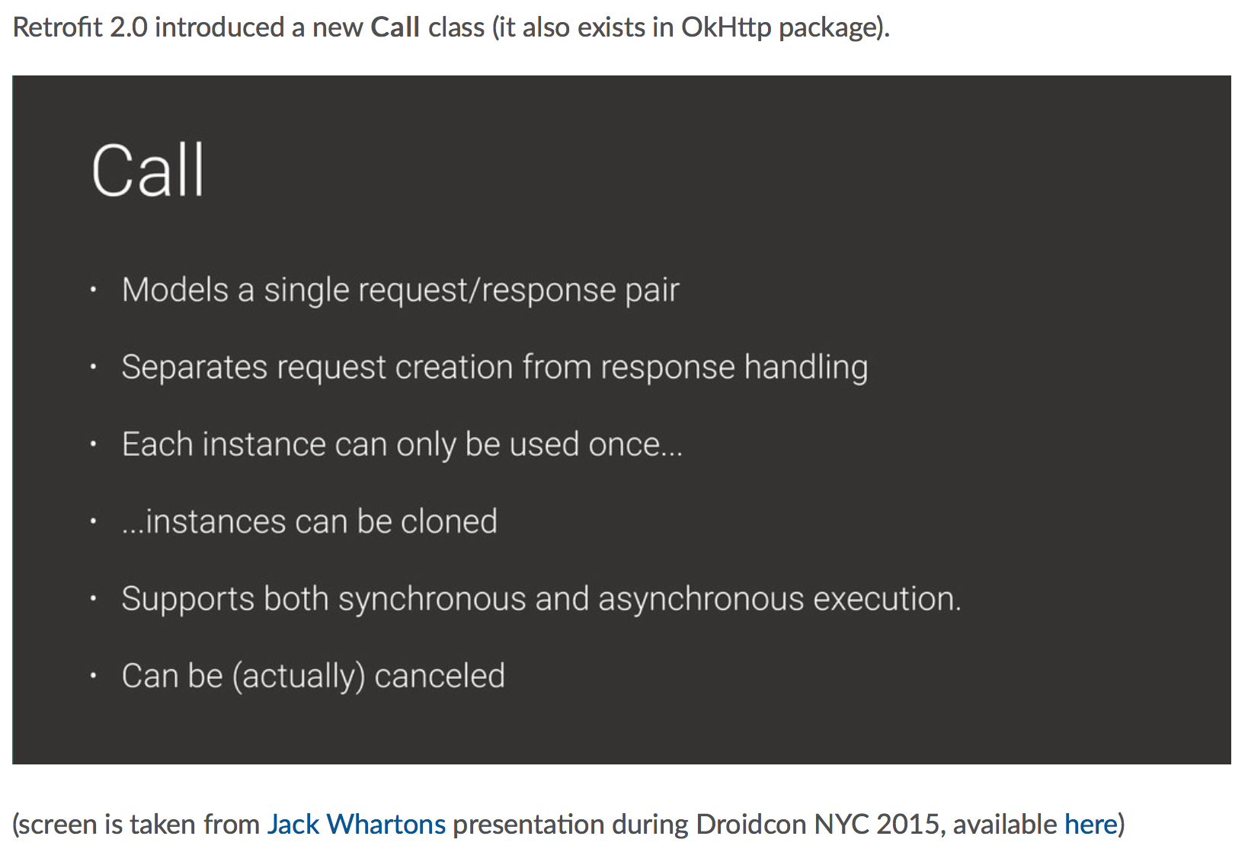
Call class

Slide 14
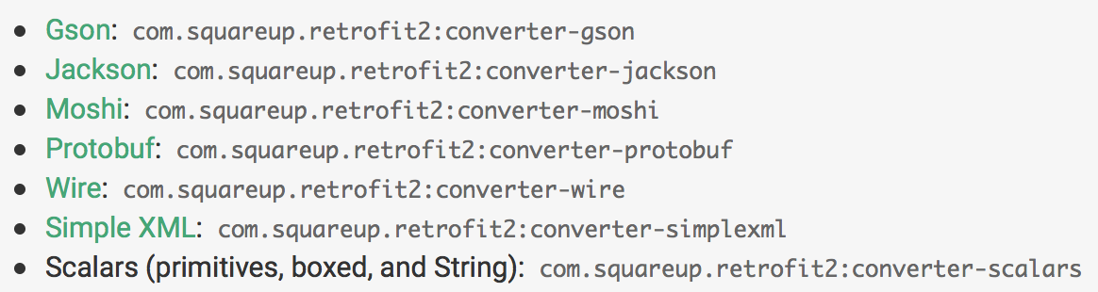
Calling the API
So how do we use this interface to make requests to the API?
Use Retrofit2 to create an implementation of the above interface, and then call the desired method.
Retrofit2 supports a number of converters used to map Java/Kotlin objects to the data format your server expects (JSON, XML, etc). We’ll be using the Gson converter.

Slide 15
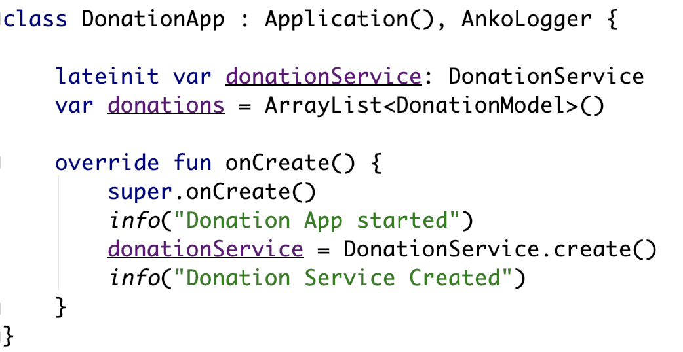
DonationApp - onCreate()
Create an instance of the proxy service ‘donationService’

Slide 16
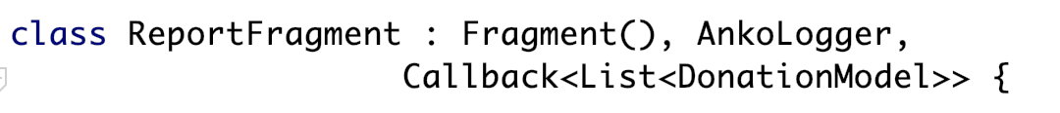
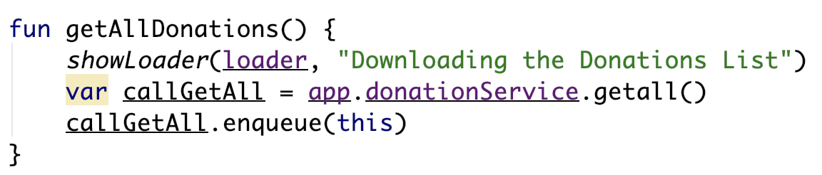
Calling the API
Note the Callback interface
Implement the necessary interface
and Callback objects
Called inside onResume()
enqueue() allows for asynchronous callback to our service

Slide 17
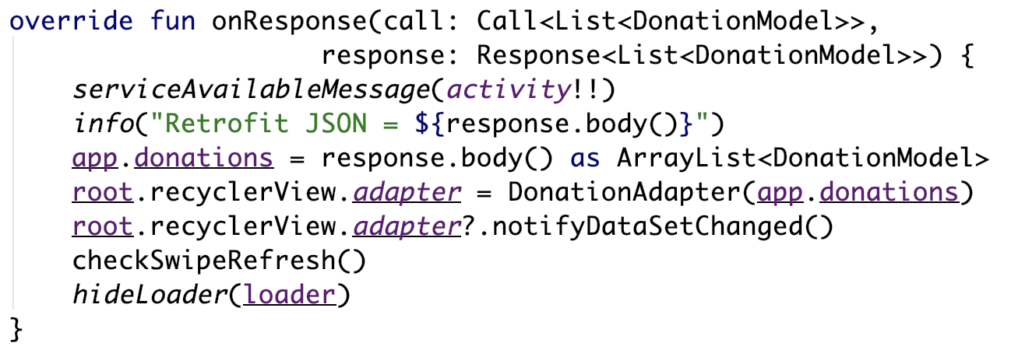
Calling the API
Note the returned response on a successful call
Override the Callback methods

Slide 18
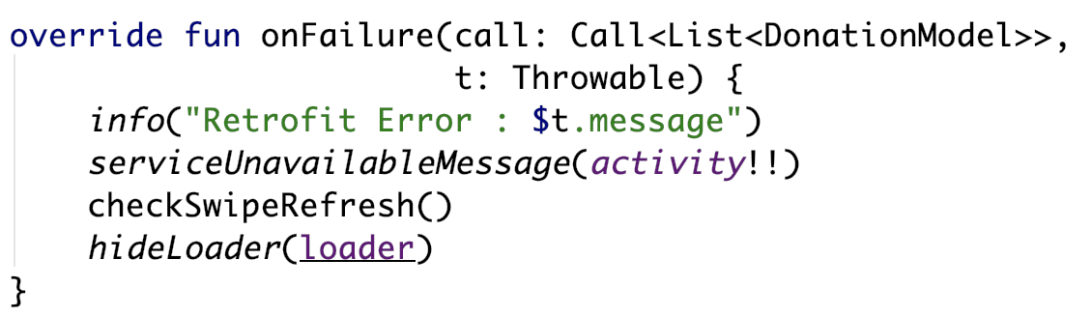
Calling the API
Note the returned t on a failed call
Override the Callback methods

Slide 19
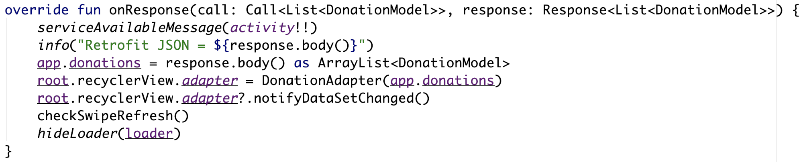
Calling the API – onResponse()
Triggered on a successful call to the API
Takes 2 parameters
The Call object
The expected Response object
Converted JSON result stored in response.body()

Slide 20
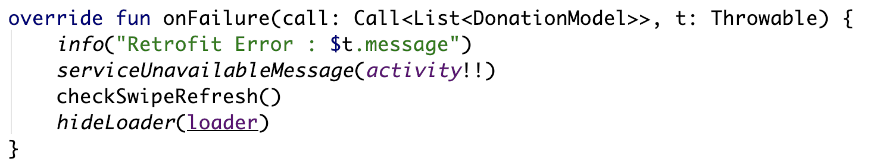
Calling the API – onFailure()
Triggered on an unsuccessful call to the API
Takes 2 parameters
The Call object
A Throwable object containing error info
Should inform user of what’s happened

Slide 21
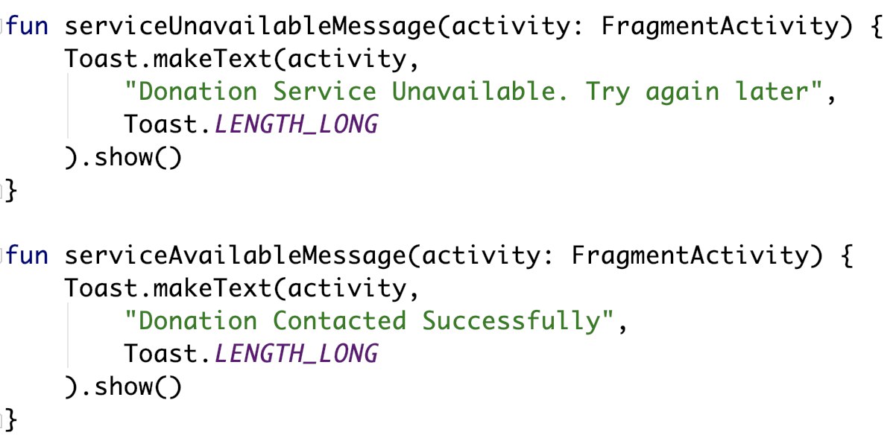
Calling the API – Helper methods
2 helper methods for user feedback

Slide 22
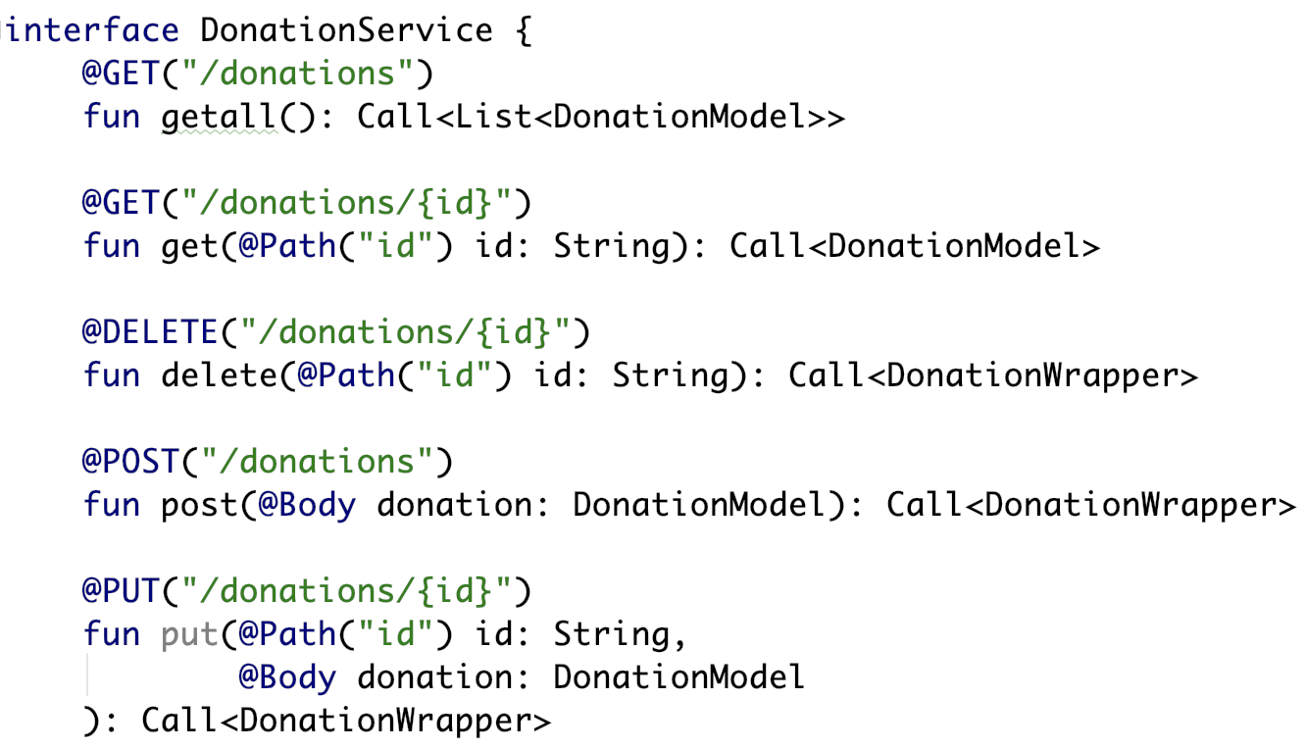
Beyond GET – other types of Calls
Retrofit2 is not limited to GET requests. You may specify other REST methods using the appropriate annotations (such as @POST, @PUT and @DELETE).
Here’s another version of our DonationService interface

Slide 23
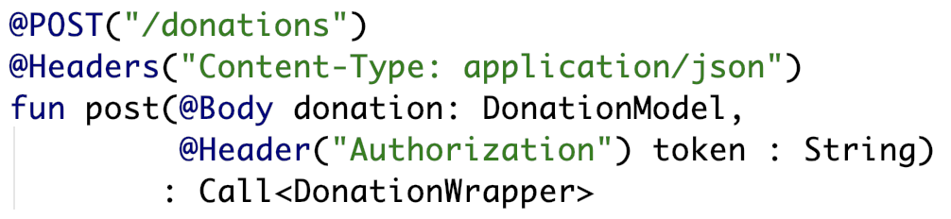
Headers
If you wish to add headers to your calls, you can annotate your method or arguments to indicate this.
For instance, if we wanted to add a content type and a user’s authentication token, we could do something like this:

Slide 24
Bridging the Gap Between Your Code & Your API
Variable Names
In the previous examples, we assumed that there was an exact mapping of instance variable names between the Donation class and the server. This will often not be the case, especially if your server uses a different spelling convention than your Android app.
For example, if you use a Rails server, you will probably be returning data using snake_case, while your Java/Kotlin probably uses camelCase. If we add a dateCreated to the Donation class, we may be receiving it from the server as date_created.
To create this mapping, use the @SerializedName annotation on the instance variable. For example:
@SerializedName("date_created")
var dateCreated : Date

Slide 25
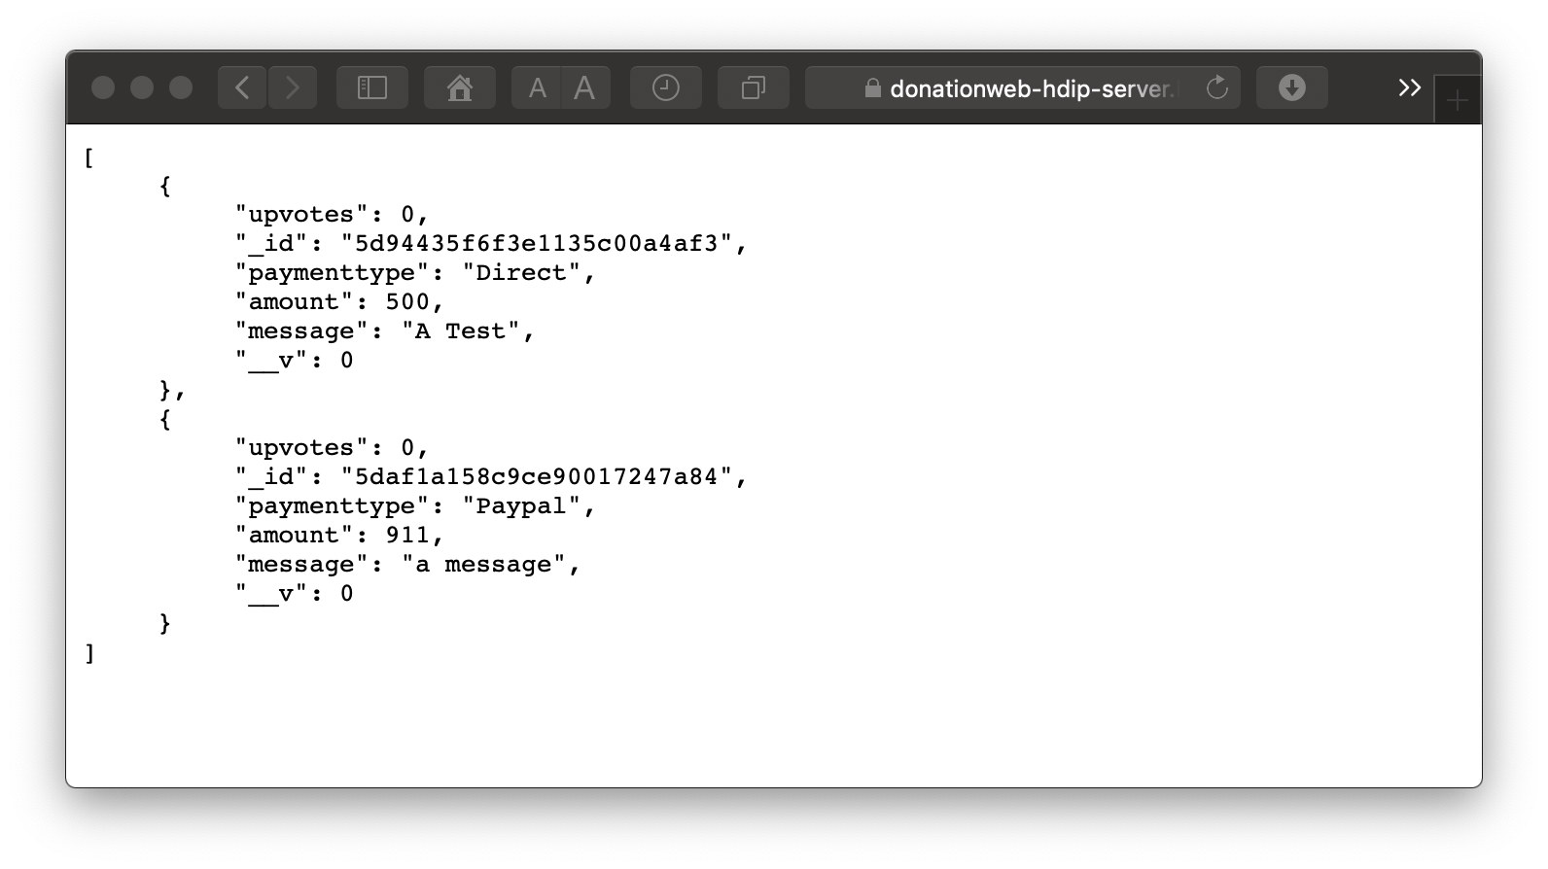
Bridging the Gap Between Your Code & Your API
You can also create your models automatically from your JSON response data by leveraging a useful tool: jsonschema2pojo - http://www.jsonschema2pojo.org
Grab your JSON string, visit the above link and paste it in, like so

Slide 26
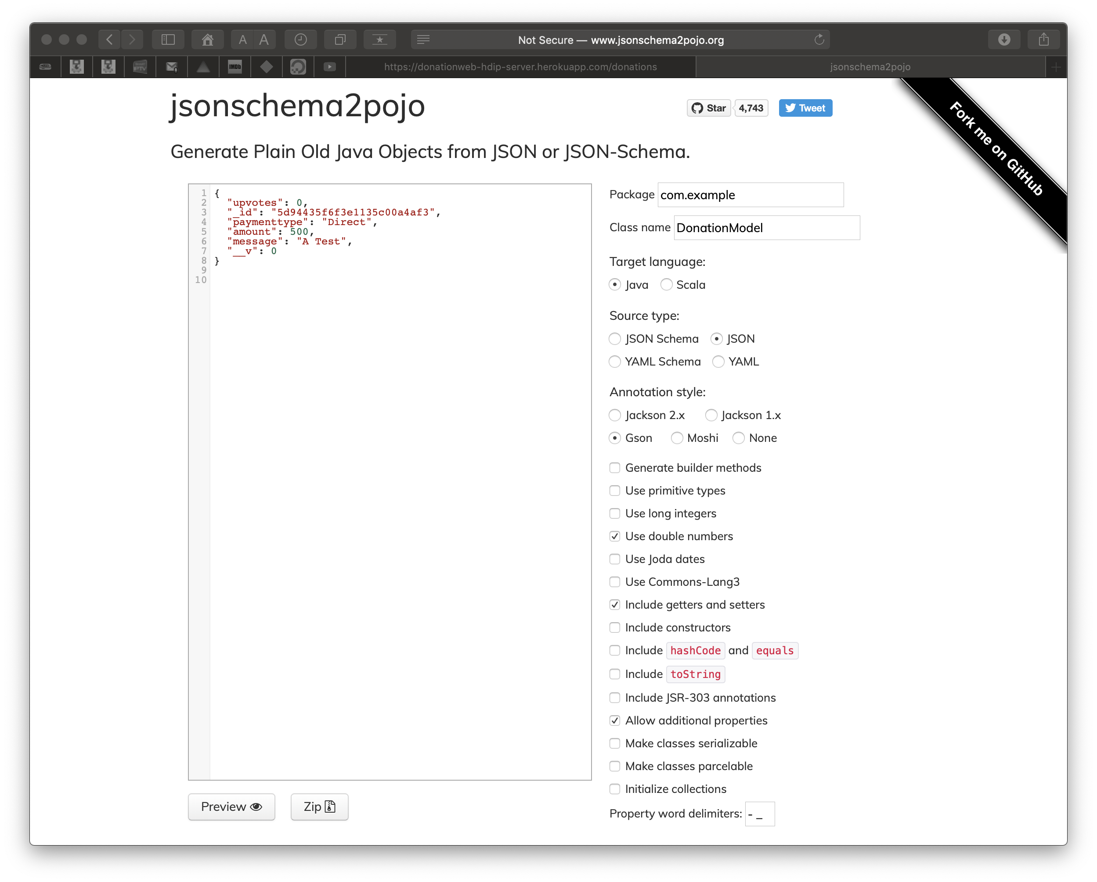
Bridging the Gap Between Your Code & Your API
Your JSON goes here

Slide 27
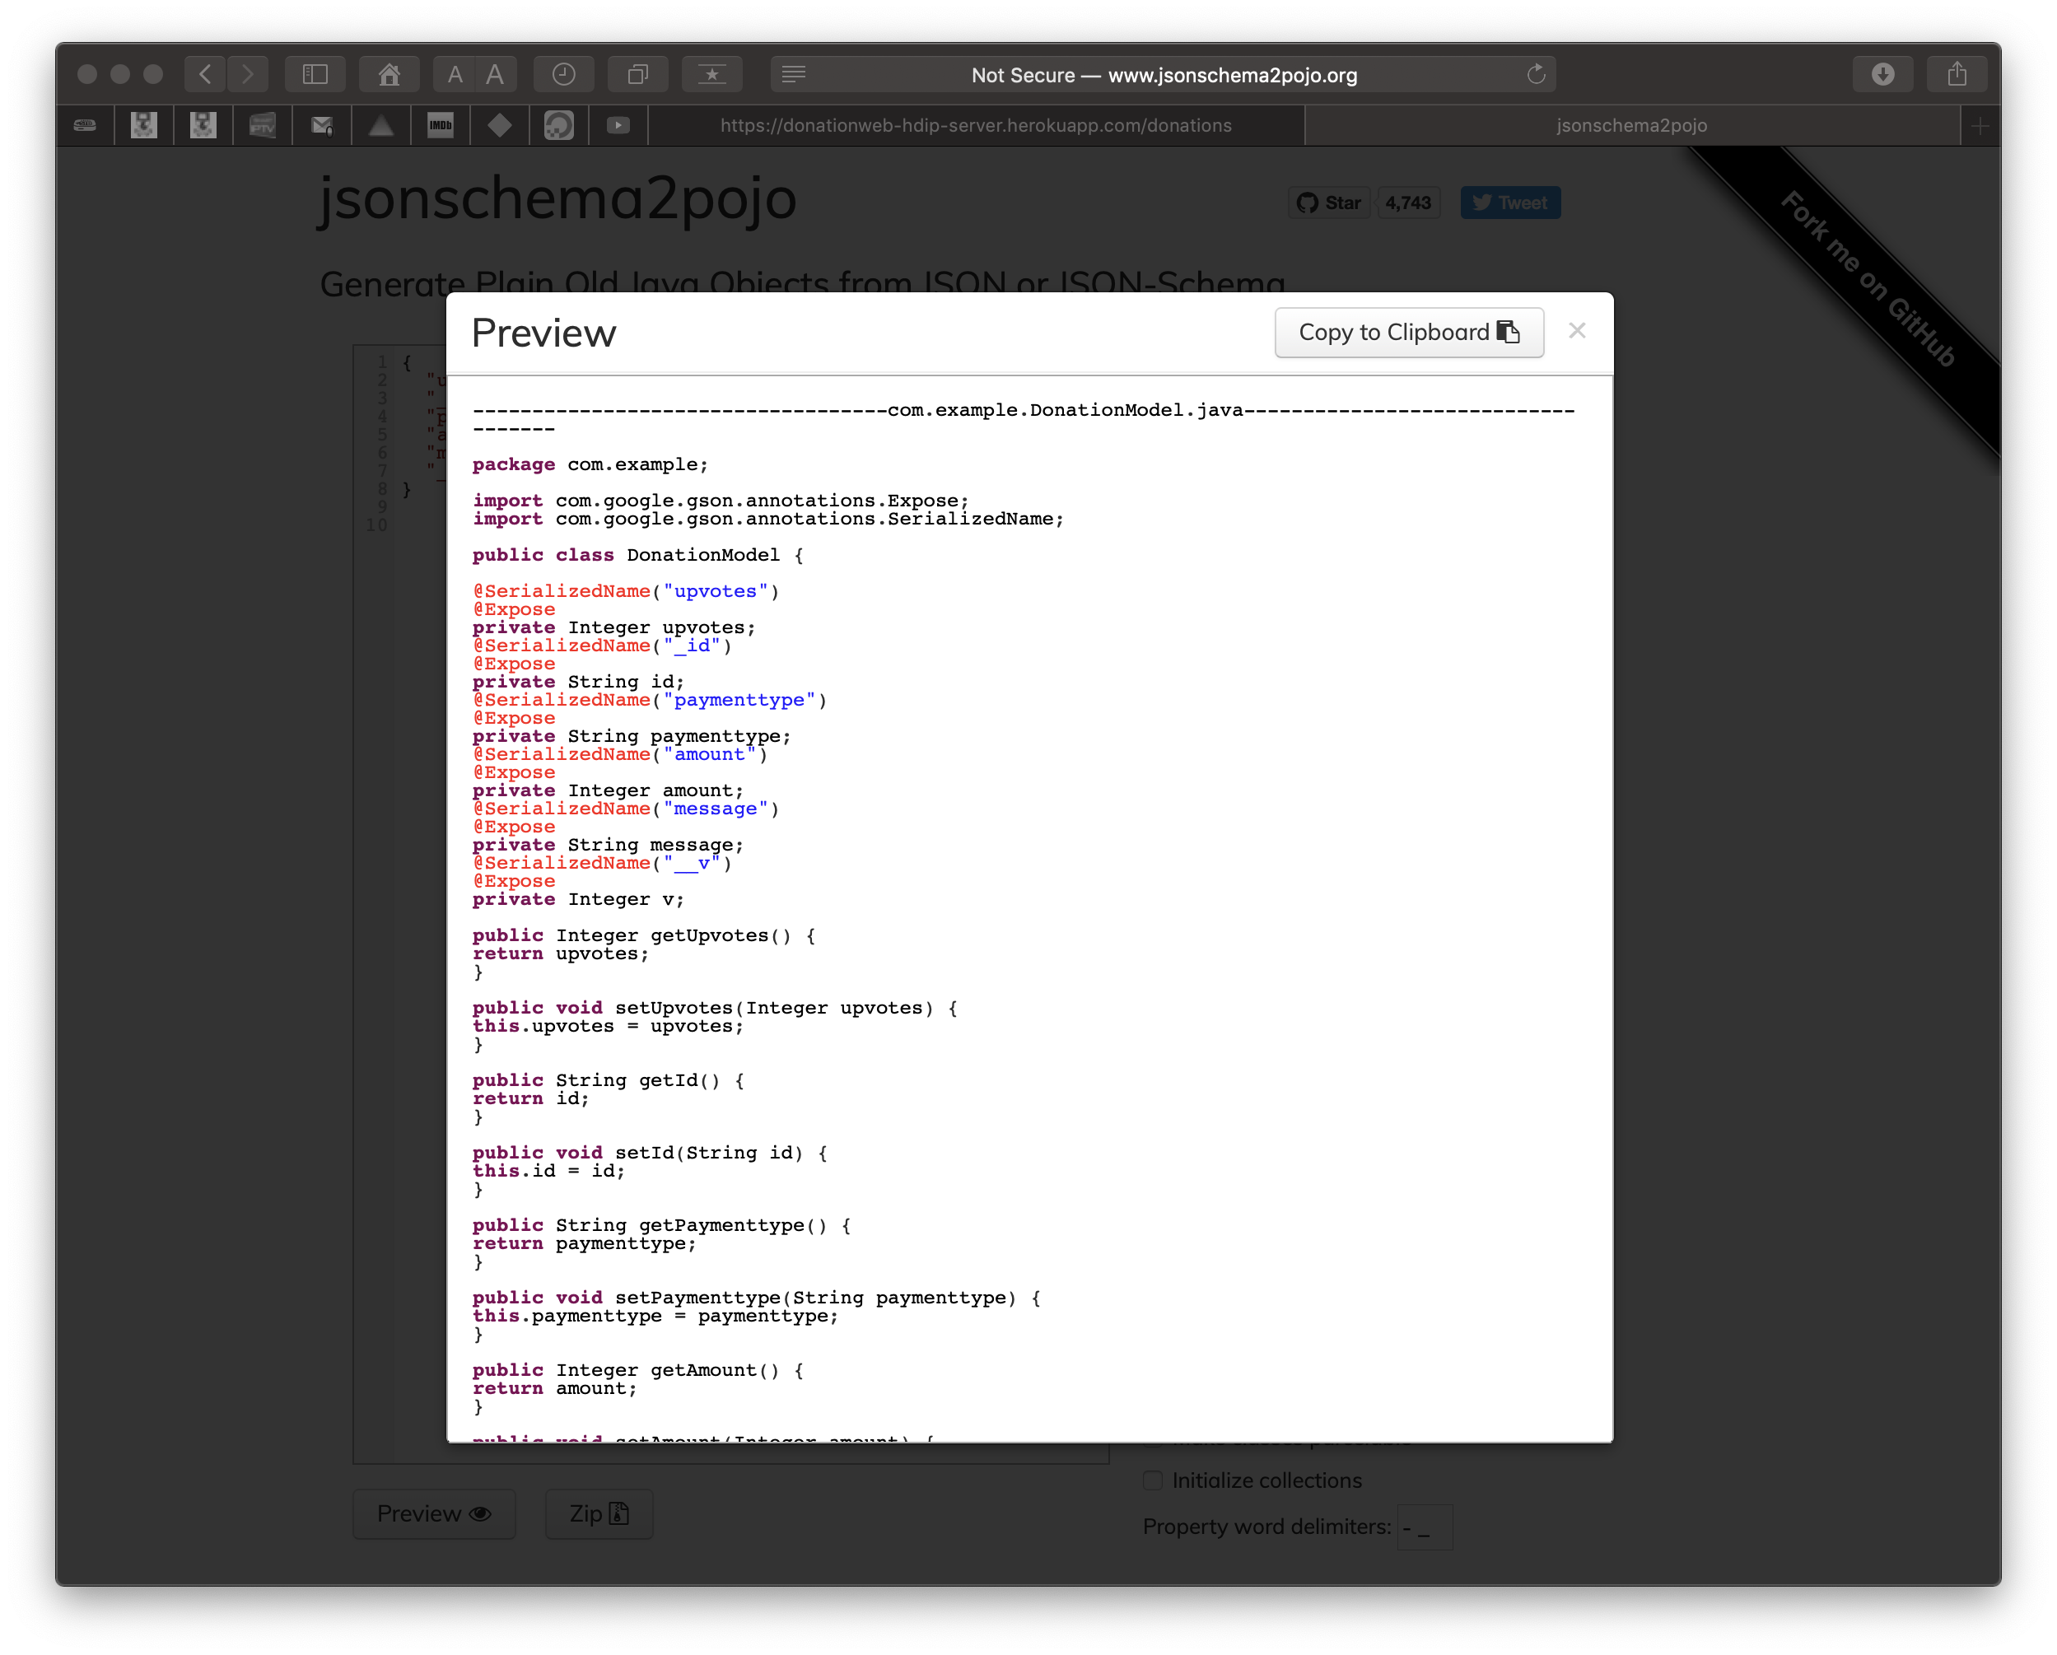
Bridging the Gap Between Your Code & Your API
Your annotated class

Slide 28
Bridging the Gap Between Your Code & Your API
Date Formats
Another potential disconnect between the app and the server is the way they represent date objects.
For instance, Rails may send a date to your app in the format "yyyy-MM-dd'T'HH:mm:ss" which Gson will not be able to convert to a Java/Kotlin Date. We have to explicitly tell the converter how to perform this conversion. In this case, we can alter the Gson builder call to look like this:
val gson = GsonBuilder()
.setDateFormat("yyyy-MM-dd'T'HH:mm:ss")
.create();

Slide 29
Full List of Retrofit Annotations
@POST
@PUT
@GET
@DELETE
@Header
@PATCH
@Path
@Query
@Body

Slide 30

References
Sources: https://square.github.io/retrofit/
https://medium.com/@prakash_pun/retrofit-a-simple-android-tutorial-48437e4e5a23
https://en.proft.me/2019/09/28/android-networking-coroutines-and-retrofit/

Slide 31


